Slide 1
Unit 5
Relational-Database Design

Slide 2
Pitfalls in Relational-Database Design
Relational database design requires that we find a “good” collection of relation schemas.
A bad design may lead to
Repetition of Information.
Inability to represent certain information.

Slide 3
Design Goals:
Avoid redundant data .
Ensure that relationships among attributes are represented .
Facilitate the checking of updates for violation of database integrity constraints.

Slide 4
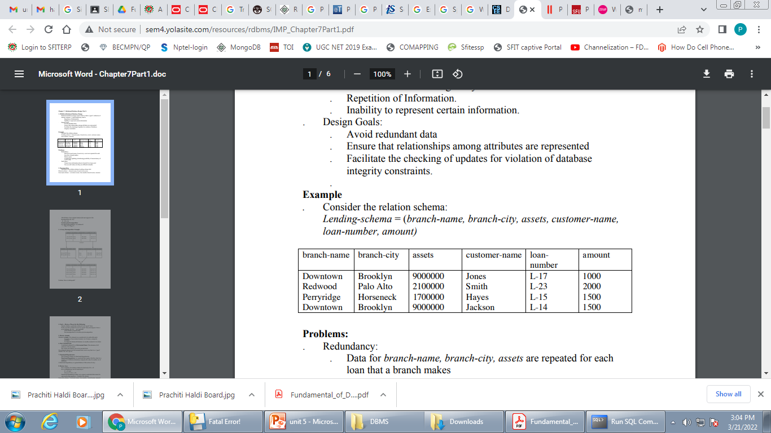
Example
Consider the relation schema:
Lending-schema = (branch-name, branch-city, assets, customer-name,loan-number, amount)

Slide 5
Problems:
Redundancy:
. Data for branch-name, branch-city, assets are repeated for each loan that a branch makes
. Wastes space
. Complicates updating
Null values .
Cannot store information about a branch if no loans exist .
Can use null values, but they are difficult to handle.

Slide 6
In the given example the database design is faulty which makes the above pitfalls in database. So we observe that in relational database design if the design is not good then there will be faults in databases.

Slide 7
Normalization
Normalization is the process of organizing the data in the database.
Normalization is used to minimize the redundancy from a relation or set of relations. It is also used to eliminate the undesirable characteristics like Insertion, Update and Deletion Anomalies.
Normalization divides the larger table into the smaller table and links them using relationship.
The normal form is used to reduce redundancy from the database table.

Slide 8
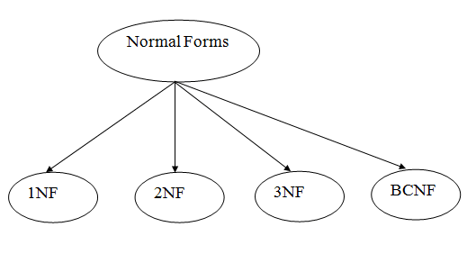
Types of Normal Forms
There are the four types of normal forms:

Slide 9
Normal Form | Description
1NF | A relation is in 1NF if it contains an atomic value.
2NF | A relation will be in 2NF if it is in 1NF and all non-key attributes are fully functional dependent on the primary key.
3NF | A relation will be in 3NF if it is in 2NF and no transition dependency exists.
4NF | A relation will be in 4NF if it is in Boyce Codd normal form and has no multi-valued dependency.
5NF | A relation is in 5NF if it is in 4NF and not contains any join dependency and joining should be lossless.

Slide 10
Problems Without Normalization
If a table is not properly normalized and have data redundancy then it will not only eat up extra memory space but will also make it difficult to handle and update the database, without facing data loss. Insertion, Updation and Deletion Anomalies are very frequent if database is not normalized.

Slide 11
Student
rollno | name | branch | hod | office_tel
401 | Akon | CSE | Mr. X | 53337
402 | Bkon | CSE | Mr. X | 53337
403 | Ckon | CSE | Mr. X | 53337
404 | Dkon | CSE | Mr. X | 53337
In the table above, we have data of 4 Computer Sci. students. As we can see, data for the fields branch, hod(Head of Department) and office_tel is repeated for the students who are in the same branch in the college, this is Data Redundancy.

Slide 12
Insertion Anomaly
Suppose for a new admission, until and unless a student opts for a branch, data of the student cannot be inserted, or else we will have to set the branch information as NULL.
Also, if we have to insert data of 100 students of same branch, then the branch information will be repeated for all those 100 students.
These scenarios are nothing but Insertion anomalies.

Slide 13
Updation Anomaly
What if Mr. X leaves the college? or is no longer the HOD of computer science department? In that case all the student records will have to be updated, and if by mistake we miss any record, it will lead to data inconsistency. This is Updation anomaly.

Slide 14
Deletion Anomaly
In our Student table, two different information's are kept together, Student information and Branch information. Hence, at the end of the academic year, if student records are deleted, we will also lose the branch information. This is Deletion anomaly.

Slide 15
First Normal Form (1NF)
A relation will be 1NF if it contains an atomic value.
It states that an attribute of a table cannot hold multiple values. It must hold only single-valued attribute.
First normal form disallows the multi-valued attribute, composite attribute, and their combinations.

Slide 16
Rules for First Normal Form
Rule 1: Single Valued Attributes
Each column of your table should be single valued which means they should not contain multiple values.
Rule 2: Attribute Domain should not change
In each column the values stored must be of the same kind or type.
For example: If you have a column dob to save date of births of a set of people, then you cannot or you must not save 'names' of some of them in that column along with 'date of birth' of others in that column. It should hold only 'date of birth' for all the records/rows.

Slide 17
Rule 3: Unique name for Attributes/Columns
This rule expects that each column in a table should have a unique name.
Rule 4: Order doesn't matters
This rule says that the order in which you store the data in your table doesn't matter

Slide 18
Example: Relation EMPLOYEE is not in 1NF because of multi-valued attribute EMP_PHONE.
EMPLOYEE table:
EMP_ID | EMP_NAME | EMP_PHONE | EMP_STATE
14 | John | 7272826385, 9064738238 | UP
20 | Harry | 8574783832 | Bihar
12 | Sam | 7390372389, 8589830302 | Punjab

Slide 19
The decomposition of the EMPLOYEE table into 1NF has been shown below:
EMP_ID | EMP_NAME | EMP_PHONE | EMP_STATE
14 | John | 7272826385 | UP
14 | John | 9064738238 | UP
20 | Harry | 8574783832 | Bihar
12 | Sam | 7390372389 | Punjab
12 | Sam | 8589830302 | Punjab

Slide 20
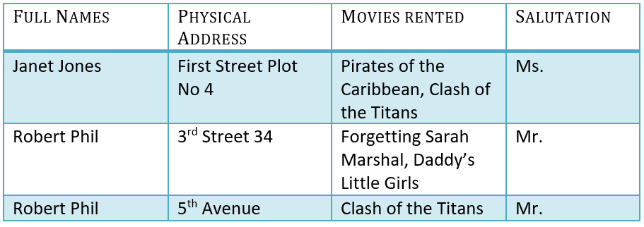
Example 2:
Assume, a video library maintains a database of movies rented out. Without any normalization in database, all information is stored in one table as shown below.

Slide 21
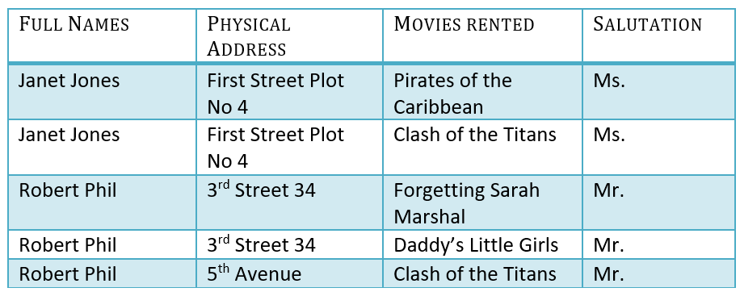
1NF Example

Slide 22
Functional Dependency
The functional dependency is a relationship that exists between two attributes. It typically exists between the primary key and non-key attribute within a table.
X → Y
The left side of FD is known as a determinant, the right side of the production is known as a dependent.

Slide 23
example:
Assume we have an employee table with attributes: Emp_Id, Emp_Name, Emp_Address.

Slide 24
Here Emp_Id attribute can uniquely identify the Emp_Name attribute of employee table because if we know the Emp_Id, we can tell that employee name associated with it.
Functional dependency can be written as:
Emp_Id → Emp_Name

Slide 25
Types of Functional Dependencies
Multivalued Dependency
Trivial Functional Dependency
Non-Trivial Functional Dependency
Transitive Dependency

Slide 26
1.Trivial Functional Dependency
The Trivial dependency is a set of attributes which are called a trivial if the set of attributes are included in that attribute.
So, X -> Y is a trivial functional dependency if Y is a subset of X.

Slide 27
Example:
Consider a table with two columns Employee_Id and
Employee_Name.
{Employee_id, Employee_Name} → Employee_Id is a
trivial functional dependency as
Employee_Id is a subset of {Employee_Id, Employee_Name}.
Also, Employee_Id → Employee_Id and
Employee_Name → Employee_Name are trivial
dependencies too

Slide 28
2. Non-trivial functional dependency
Functional dependency which also known as a nontrivial dependency occurs when A->B holds true where B is not a subset of A.
In a relationship, if attribute B is not a subset of attribute A, then it is considered as a non-trivial dependency.
A → B has a non-trivial functional dependency if B is not a subset of A.
When A intersection B is NULL, then A → B is called as complete non-trivial.
Example:
ID → Name
Name → DOB

Slide 29
Company | CEO | Age
Microsoft | Satya Nadella | 51
Google | Sundar Pichai | 46
Apple | Tim Cook | 57
Example:
(Company} -> {CEO}
(if we know the Company, we knows the CEO name)
But CEO is not a subset of Company, and hence it’s non-trivial functional dependency.

Slide 30
3.Multivalued Dependency in DBMS
Multivalued dependency occurs when two attributes in a table are independent of each other but, both depend on a third attribute.
A multivalued dependency consists of at least two attributes that are dependent on a third attribute that's why it always requires at least three attributes.

Slide 31
Example:
Car_model | Manufacturing year | Color
H001 | 2017 | Metallic
H001 | 2017 | Green
H005 | 2018 | Metallic
H005 | 2018 | Blue
H010 | 2015 | Metallic
H033 | 2012 | Gray
In this example, year and color are independent of each other but dependent on car_model. In this example, these two columns are said to be multivalue dependent on car_model.
This dependence can be represented like this:
car_model -> Manufacturing year
car_model-> colour

Slide 32
4.Transitive Dependency in DBMS
A Transitive Dependency is a type of functional dependency which happens when “t” is indirectly formed by two functional dependencies.
Consider a relation R(A B C) where A, B and C are the attributes of the relation R.
A Transitive dependency exists when we have the following functional dependency pattern A→B and B → C; therefore, A → C

Slide 33
Example:
Company | CEO | Age
Microsoft | Satya Nadella | 51
Google | Sundar Pichai | 46
Alibaba | Jack Ma | 54

Slide 34
{Company} -> {CEO}
(if we know the company, we know its CEO’s name)
{CEO } -> {Age}
If we know the CEO, we know the Age
Therefore according to the rule of rule of transitive dependency:
{ Company} -> {Age} should hold, that makes sense because if we know the company name, we can know his age.

Slide 35
Second Normal Form (2NF)
The second step in Normalization is 2NF.
A table is in 2NF, only if a relation is in 1NF and meet all the rules, and every non-key attribute is fully dependent on primary key.
The Second Normal Form eliminates partial dependencies on primary keys.

Slide 36
Example
<StudentProject>
StudentID | ProjectID | StudentName | ProjectName
S89 | P09 | Olivia | Geo Location
S76 | P07 | Olivia | Geo Location
S56 | P03 | Ava | IoT Devices
S92 | P05 | Alexandra | Cloud Deployment

Slide 37
In the above table, we have partial dependency;
The prime key attributes are StudentID and ProjectID.
The non-prime attributes i.e. StudentName and ProjectName should be functionally dependent on part of a candidate key, to be Partial Dependent.
The StudentName can be determined by StudentID, which makes the relation Partial Dependent.
The ProjectName can be determined by ProjectID, which makes the relation Partial Dependent.
Therefore, the <StudentProject> relation violates the 2NF in Normalization and is considered a bad database design.

Slide 38
Example (Table converted to 2NF)
To remove Partial Dependency and violation on 2NF, decompose the above tables −
<StudentInfo>
StudentID | ProjectID | StudentName
S89 | P09 | Olivia
S76 | P07 | Olivia
S56 | P03 | Ava
S92 | P05 | Alexandra

Slide 39
<ProjectInfo>
ProjectID | ProjectName
P09 | Geo Location
P07 | Geo Location
P03 | IoT Devices
P05 | Cloud Deployment

Slide 40
Example 2: Let's assume, a school can store the data of teachers and the subjects they teach. In a school, a teacher can teach more than one subject.
TEACHER table
TEACHER_ID | SUBJECT | TEACHER_AGE
25 | Chemistry | 30
25 | Biology | 30
47 | English | 35
83 | Math | 38
83 | Computer | 38

Slide 41
In the given table, non-prime attribute TEACHER_AGE is dependent on TEACHER_ID which is a proper subset of a candidate key. That's why it violates the rule for 2NF.
To convert the given table into 2NF, we decompose it into two tables:

Slide 42
TEACHER_DETAIL table:
TEACHER_ID | TEACHER_AGE
25 | 30
47 | 35
83 | 38
TEACHER_SUBJECT table:
TEACHER_ID | SUBJECT
25 | Chemistry
25 | Biology
47 | English
83 | Math
83 | Computer

Slide 43
Third Normal Form (3NF)
A relation will be in 3NF if it is in 2NF and not contain any transitive partial dependency.
3NF is used to reduce the data duplication. It is also used to achieve the data integrity.
If there is no transitive dependency for non-prime attributes, then the relation must be in third normal form.
A relation is in third normal form if it holds atleast one of the following conditions for every non-trivial function dependency X → Y.
X is a super key.
Y is a prime attribute, i.e., each element of Y is part of some candidate key.

Slide 44
Example:
EMPLOYEE_DETAIL table:
EMP_ID | EMP_NAME | EMP_ZIP | EMP_STATE | EMP_CITY
222 | Harry | 201010 | UP | Noida
333 | Stephan | 02228 | US | Boston
444 | Lan | 60007 | US | Chicago
555 | Katharine | 06389 | UK | Norwich
666 | John | 462007 | MP | Bhopal

Slide 45
Super key in the table above:
{EMP_ID}, {EMP_ID, EMP_NAME}, {EMP_ID, EMP_NAME, EMP_ZIP}....so on
Candidate key: {EMP_ID}
Non-prime attributes: In the given table, all attributes except EMP_ID are non-prime.

Slide 46
Here, EMP_STATE & EMP_CITY dependent on EMP_ZIP and EMP_ZIP dependent on EMP_ID. The non-prime attributes (EMP_STATE, EMP_CITY) transitively dependent on super key(EMP_ID). It violates the rule of third normal form.
That's why we need to move the EMP_CITY and EMP_STATE to the new <EMPLOYEE_ZIP> table, with EMP_ZIP as a Primary key.

Slide 47
EMPLOYEE table:
EMP_ID | EMP_NAME | EMP_ZIP
222 | Harry | 201010
333 | Stephan | 02228
444 | Lan | 60007
555 | Katharine | 06389
666 | John | 462007

Slide 48
EMPLOYEE_ZIP table:
EMP_ZIP | EMP_STATE | EMP_CITY
201010 | UP | Noida
02228 | US | Boston
60007 | US | Chicago
06389 | UK | Norwich
462007 | MP | Bhopal

Slide 49
Example (Table violates 3NF)
<MovieListing>
Movie_ID | Listing_ID | Listing_Type | DVD_Price ($)
0089 | 007 | Comedy | 100
0090 | 003 | Action | 150
0091 | 007 | Comedy | 100
The above table is not in 3NF because it has a transitive functional dependency −
.
Movie_ID -> Listing_ID Listing_ID -> Listing_Type
Therefore, Movie_ID -> Listing_Type i.e. transitive functional dependency

Slide 50
Example (Table converted to 3NF)
To form it in 3NF, you need to split the tables and remove the transitive functional dependency.
<Movie>
Movie_ID | Listing_ID | DVD_Price ($)
0089 | 007 | 100
0090 | 003 | 150
0091 | 007 | 100

Slide 51
<Listing>
Listing_ID | Listing_Type
007 | Comedy
003 | Action
007 | Comedy

Slide 52
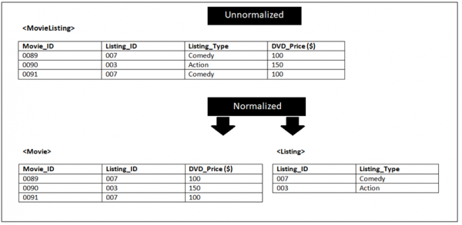

Slide 53
Boyce Codd normal form (BCNF)
BCNF is the advance version of 3NF. It is stricter than 3NF.
A table is in BCNF if every functional dependency X → Y, X is the super key of the table.
For BCNF, the table should be in 3NF, and for every FD, LHS is super key.

Slide 54
Example: Let's assume there is a company where employees work in more than one department.
EMPLOYEE table:
EMP_ID | EMP_COUNTRY | EMP_DEPT | DEPT_TYPE | EMP_DEPT_NO
264 | India | Designing | D394 | 283
264 | India | Testing | D394 | 300
364 | UK | Stores | D283 | 232
364 | UK | Developing | D283 | 549

Slide 55
In the above table Functional dependencies are as follows:
EMP_ID → EMP_COUNTRY
EMP_DEPT → {DEPT_TYPE, EMP_DEPT_NO}
Candidate key: {EMP-ID, EMP-DEPT}
The table is not in BCNF because neither EMP_DEPT nor EMP_ID alone are keys.
To convert the given table into BCNF, we decompose it into three tables:

Slide 56
EMP_COUNTRY table:
EMP_ID | EMP_COUNTRY
264 | India
264 | India

Slide 57
EMP_DEPT table:
EMP_DEPT | DEPT_TYPE | EMP_DEPT_NO
Designing | D394 | 283
Testing | D394 | 300
Stores | D283 | 232
Developing | D283 | 549

Slide 58
EMP_DEPT_MAPPING table:
EMP_ID | EMP_DEPT
D394 | 283
D394 | 300
D283 | 232
D283 | 549

Slide 59
Functional dependencies:
EMP_ID → EMP_COUNTRY
EMP_DEPT → {DEPT_TYPE, EMP_DEPT_NO}
Candidate keys:
For the first table: EMP_ID For the second table: EMP_DEPT For the third table: {EMP_ID, EMP_DEPT}
Now, this is in BCNF because left side part of both the functional dependencies is a key.

